Slide 1

VANILLA SYSTEMS: TEST RESULTS
TEAM 5: Thushal Venkatesh
IT-493-DL1
3/23/2023

Slide 2

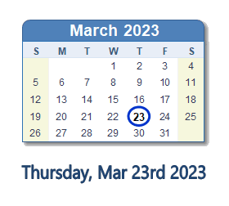
DATE OF TESTS
Every feature/functions was tested on Thursday the 23rd of March.
Tests that were conducted includes
Website Functionalities
Industry standard user navigation
Security
Scalability and Compatibility
Note: This test environment will be conducted on VMware to mimic the final product once hosted.

Slide 3
DISCLAIMER
Please note that the website you are currently viewing is in the alpha stage of development for Vanilla System. This is our earliest work and serves as a prototype to showcase the basic functionalities and design. The site may have a limited set of features and content that are still under development, and as such, may contain bugs, errors, and incomplete features. We are actively working to improve the website and appreciate your patience as we continue to refine and perfect its functionality and design. Your feedback and suggestions at this early stage would be greatly appreciated and will be taken into consideration as we progress through the development process. Thank you for your understanding.

Slide 4
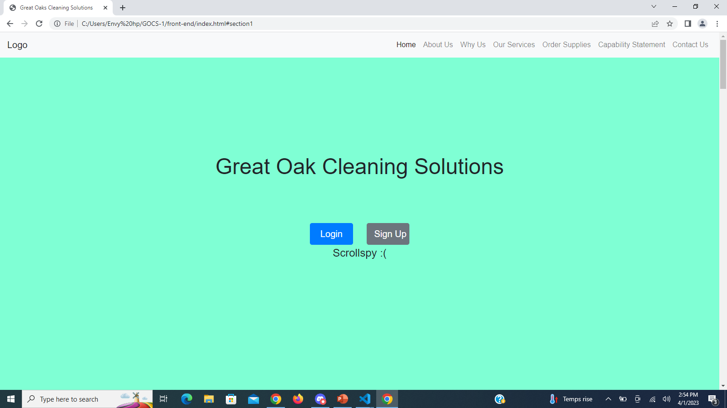
Alpha stage website

Slide 5
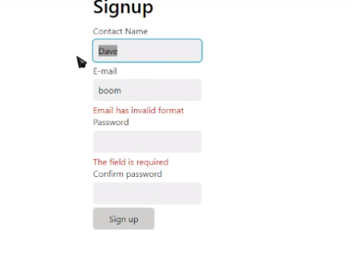
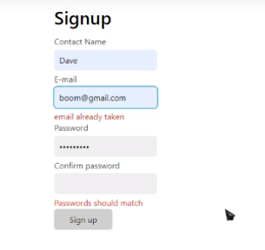
Sign-up Error Testing

Slide 6
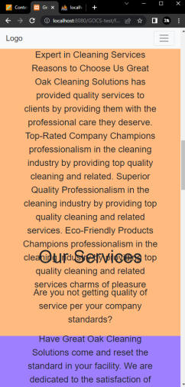
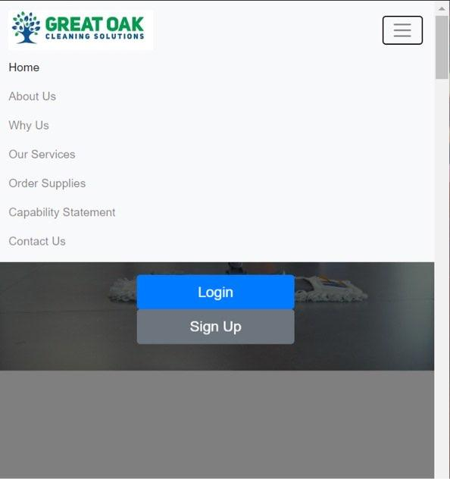
Scaling/Responsiveness Test

Slide 7
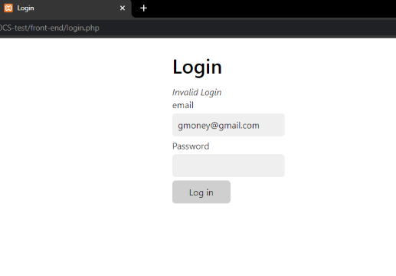
Bad Login Attempt
Notes:
Bad login attempt, does not tell user why.login failed.

Slide 8
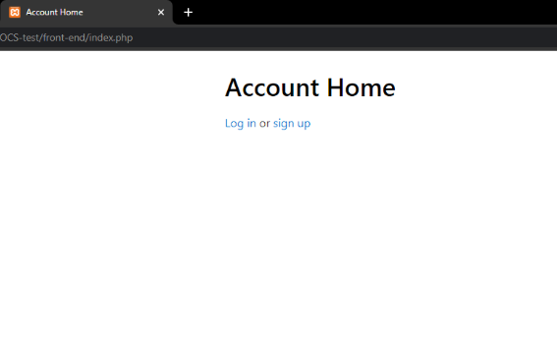
Logout Landing Page
Notes:
Logout landing page, redirects to login or home.

Slide 9
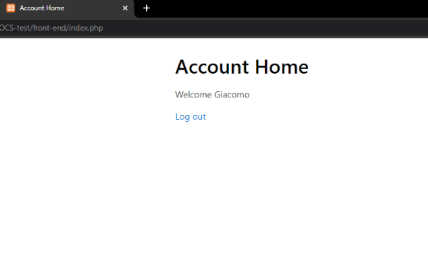
Account Dashboard Page for Client
Notes:
Account dashboard page for client, will display account info, allow for updates, provide feedback once implementation is complete.

Slide 10
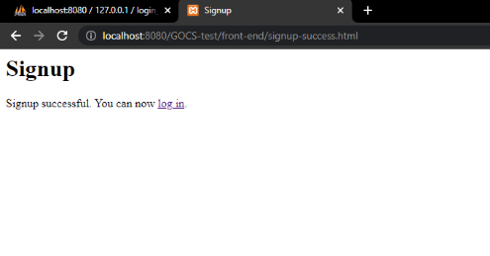
Account Successfully Created
Notes:
Account successfully created, redirects to login or home.

Slide 11
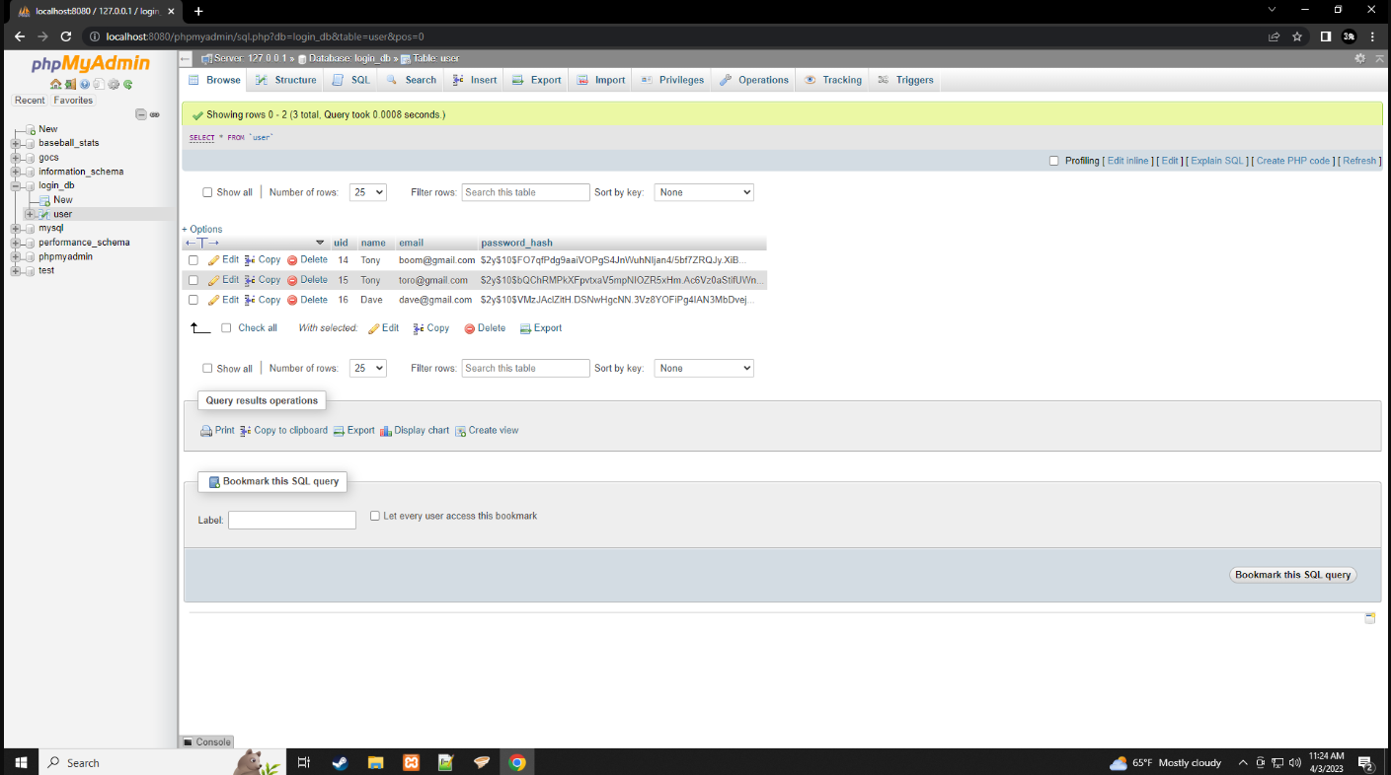
Test Data Storage
Notes:
Test data stored in database, plain text passwords are converted to salted hashes.

Slide 12
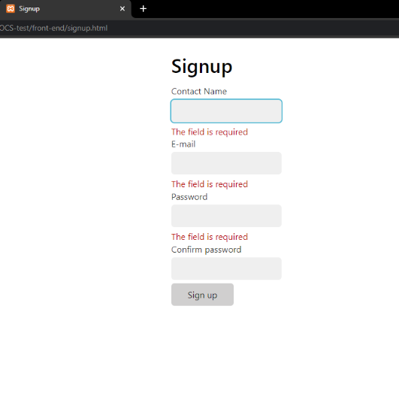
Submitting No Data
Notes:
Trying to submit no data results in these errors.

Slide 13
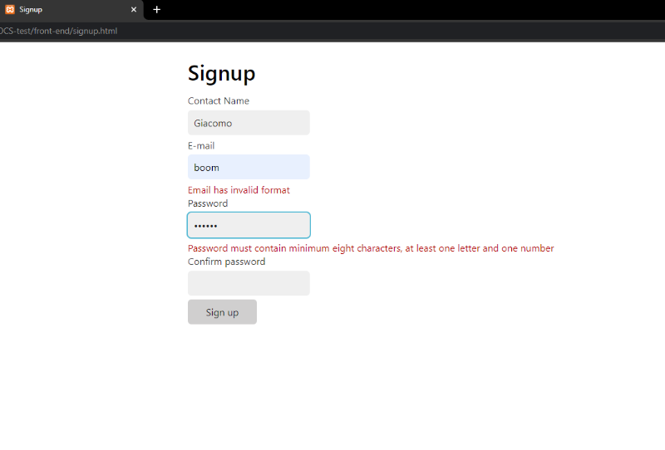
Passwords Don’t Match
Notes:
Passwords don’t match

Slide 14
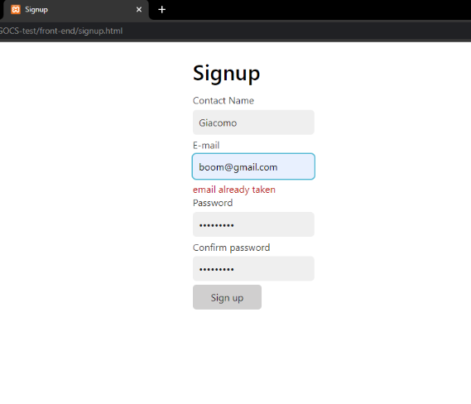
Using Existing Email
Notes:
Trying to use existing email to make an account(email must be unique).

Slide 15
NON-FUNCTIONAL TESTING
Steps | Description | Expected Results | Alpha Testing Date & Time | Pass or Fail | Non-Function Testing Date & Time | Pass or Fail
Loading | What’s the average load time? | <3 seconds | 3/23/2023 - Pass | 3/23/2023 - Pass
Device Friendly | Is it consistent across devices? | Yes, can be used on a phone | 3/23/2023 - Pass | 3/23/2023 - Pass
Ease of Use | Is it user-friendly? | Yes, industry standard in ease-of-use | 3/23/2023 - Pass | 3/23/2023 - Pass
Patching/Maintenance | How often does maintenance occur? | During patch implementations | 3/23/2023 - Pass | 3/23/2023 - Pass
HTTPS? | Is the website secure? | Yes | Fail | 3/23/2023 – Fail, hosting provider not selected yet.
Screen and Resolution Sizing | Responsive Web Design | Yes, web pages mimic its functions across all devices. | 3/23/2023 - Pass | 3/23/2023 - Pass
Operational & Service Time | What is the website uptime and availability? | 100% uptime and availability | 3/23/2023 - Pass | 3/23/2023 - Pass
Notes:
During the meeting, we talked to our client about their options for hosting providers that offer industry-standard security measures at an affordable price.
Furthermore, we have enforced procedural coding standards on both our back-end and front-end, which are regularly reviewed by team members to ensure that all developers working on this project adhere to secure coding practices and standards. This helps minimize the risk of introducing security vulnerabilities during the development process.
Performing security audits is not within our control, but we will suggest it as an option for our client to consider before launching the website to the public.
Our client is considering implementing additional security measures such as 2 factor authentications, which would provide an extra layer of protection for their assets and customer information. However, due to the associated cost and concerns about our ability to successfully complete the project within the remaining timeline, our client has not yet made a final decision on whether to pursue this option. Additionally, our expertise in this field is limited, which further complicates the decision-making process.

Slide 16
FUNCTIONAL TESTING
Step Name | Description | Expected Results | Alpha Testing Date & Time | Pass or Fail | Functional Testing Date & Time | Pass or Fail
Navigation | Links and Menus to allow ease of guidance in browsing. | All links and menus are functional | 3/23/2023 - Pass | 3/23/2023 - Pass
User Authentication | Login and registration functionalities | Allow users to log-in to their account | 3/23/2023 - Pass | 3/23/2023 - Pass
Forms | Input Field, Drop-Down Menus, Checkboxes, | Text box fillable, menus are dynamic | 3/23/2023 - Pass | 3/23/2023 - Pass
Menu Option Extension | Individual tabs open when middle mouse is pressed on a menu option | Extend the tab for specific menu. | 3/23/2023 - Pass | 3/23/2023 - Pass
Mouse Properties | Right mouse-click on Windows background. Select Properties | Displays a list of properties | 3/23/2023 - Pass | 3/23/2023 - Pass
Compatibility | Operable under different browsers | Can be opened on chrome, edge, etc. | 3/23/2023 - Pass | 3/23/2023 - Pass
Exiting | Close Browser | Browser closes on tab exiting. | 3/23/2023 - Pass | 3/23/2023 - Pass
Notes:
The application is tested by providing input and then the results are examined that need to conform to the functionality it was intended for.
Functional testing of a software is conducted on a complete, integrated system to evaluate the system's compliance with its specified requirements.
If fail, discuss reasons.

Slide 17
References
Lehman, J. (2023). How to write a great software test plan. How to Write a Great Software Test Plan. Retrieved March 21, 2023, from https://microtoolsinc.com/papers/how-test-plan/
Lutkevich, B., & Lewis, S. (2022, November 14). What is the waterfall model? - definition and guide. Software Quality. Retrieved March 21, 2023, from https://www.techtarget.com/searchsoftwarequality/definition/waterfall-model
Rice, R. W. (2023). What is a test plan? The Complete Guide for writing a Software Test Plan. PractiTest. Retrieved March 21, 2023, from https://www.practitest.com/qa-learningcenter/best-practices/write-a-test-plan/
Tutorialspoint. (2023). Software testing - quick guide. Online Tutorials Library. Retrieved March 21, 2023, from http://www.tutorialspoint.com/software_testing/software_testing_quick_guide.htm

